Slide 1
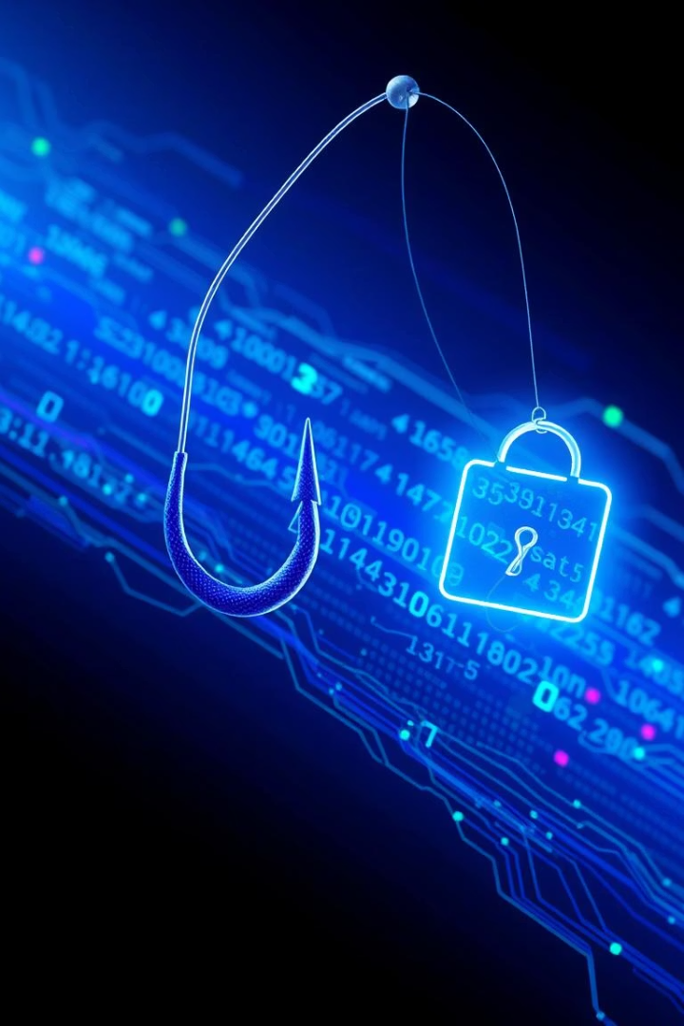
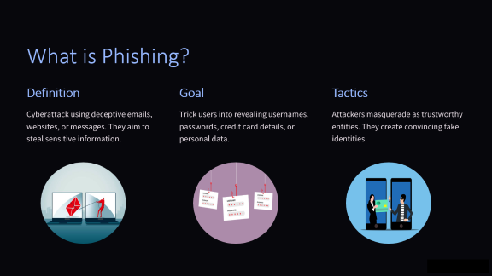
Phishing Awareness Training: Don't Get Hooked!
Protect yourself and your organization from phishing attacks. 91% of cyberattacks start with a phishing email. The average cost of a data breach is $4.45 million. Stay alert and informed.

Slide 2
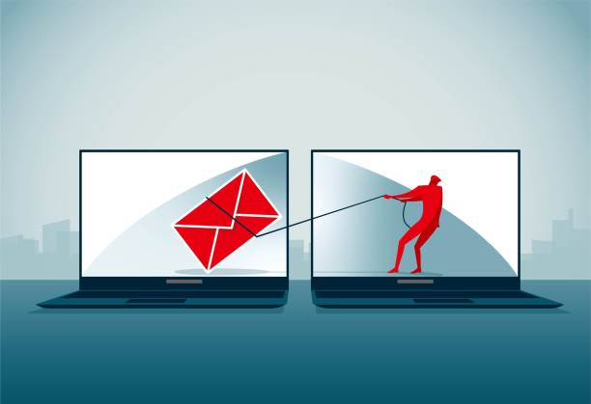
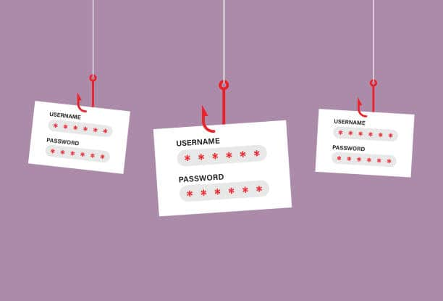
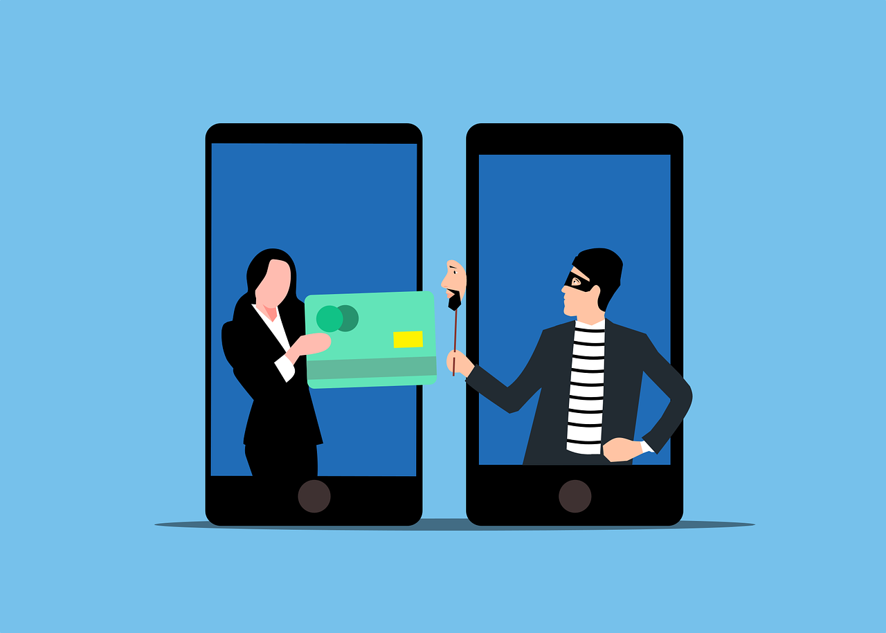
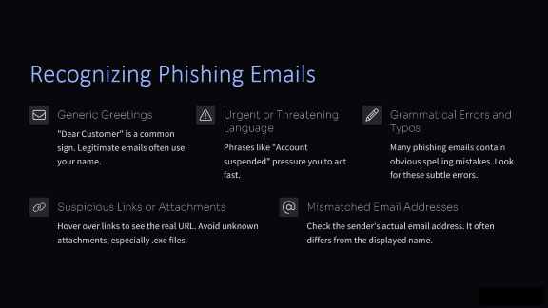
What is Phishing?
Definition
Goal
Tactics
Cyberattack using deceptive emails, websites, or messages. They aim to steal sensitive information.
Trick users into revealing usernames, passwords, credit card details, or personal data.
Attackers masquerade as trustworthy entities. They create convincing fake identities.

Slide 3





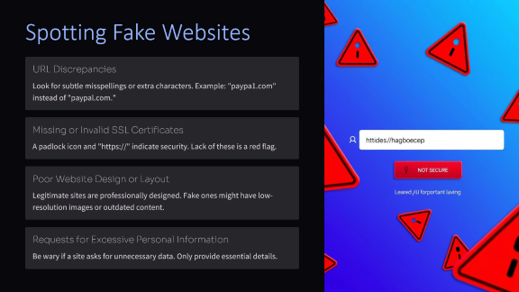
Recognizing Phishing Emails
Generic Greetings
Urgent or Threatening Language
Grammatical Errors and Typos
"Dear Customer" is a common sign. Legitimate emails often use your name.
Phrases like "Account suspended" pressure you to act fast.
Many phishing emails contain obvious spelling mistakes. Look for these subtle errors.
Suspicious Links or Attachments
Mismatched Email Addresses
Hover over links to see the real URL. Avoid unknown attachments, especially .exe files.
Check the sender's actual email address. It often differs from the displayed name.

Slide 4
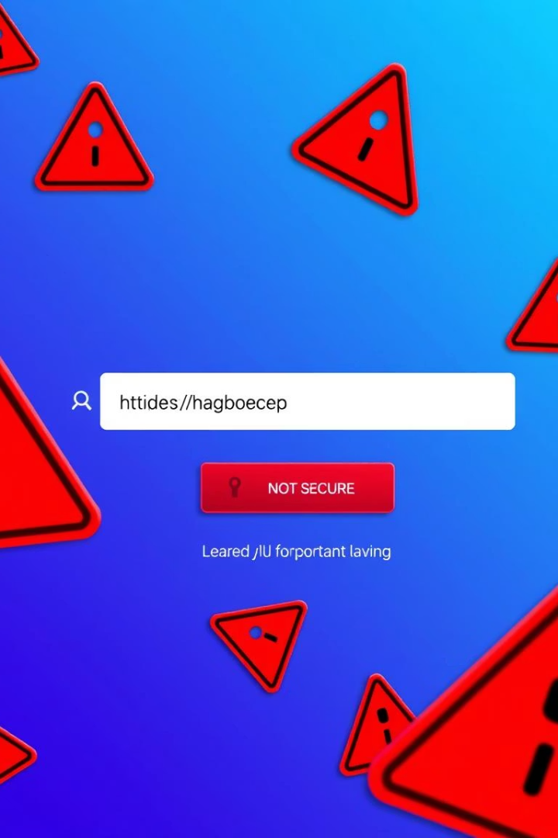
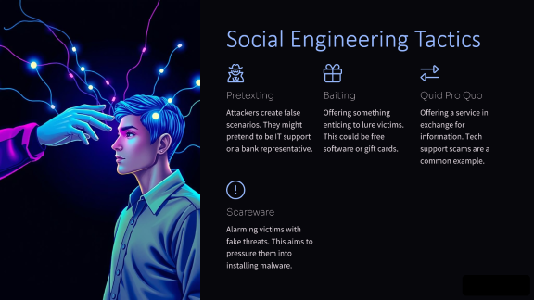
Spotting Fake Websites
URL Discrepancies
Look for subtle misspellings or extra characters. Example: "paypa1.com" instead of "paypal.com."
Missing or Invalid SSL Certificates
A padlock icon and "https://" indicate security. Lack of these is a red flag.
Poor Website Design or Layout
Legitimate sites are professionally designed. Fake ones might have low-resolution images or outdated content.
Requests for Excessive Personal Information
Be wary if a site asks for unnecessary data. Only provide essential details.

Slide 5





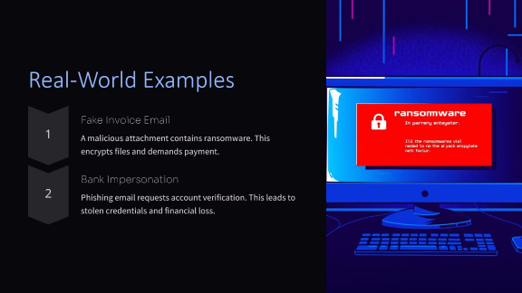
Social Engineering Tactics
Pretexting
Baiting
Quid Pro Quo
Attackers create false scenarios. They might pretend to be IT support or a bank representative.
Offering something enticing to lure victims. This could be free software or gift cards.
Offering a service in exchange for information. Tech support scams are a common example.
Scareware
Alarming victims with fake threats. This aims to pressure them into installing malware.

Slide 6
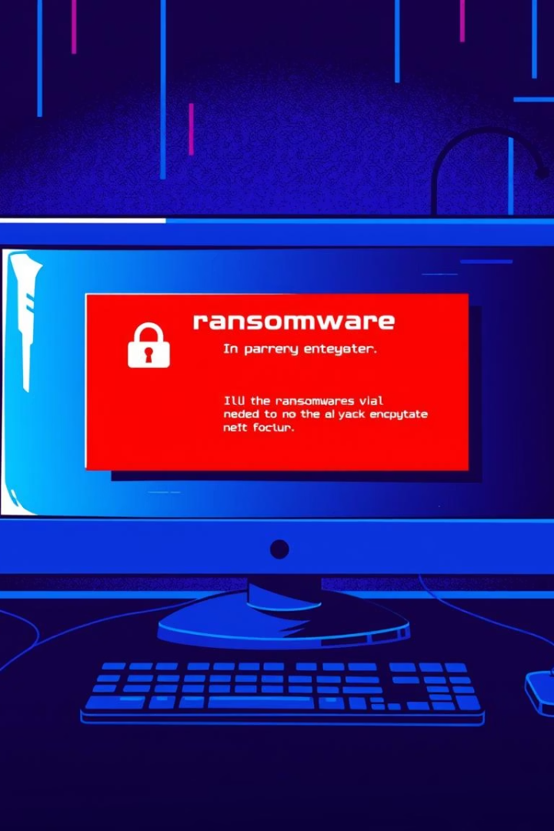


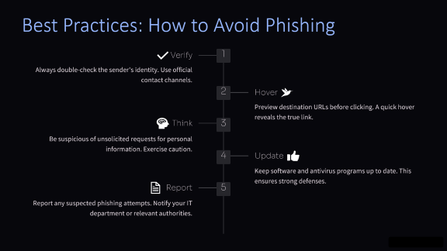
Real-World Examples
Fake Invoice Email
A malicious attachment contains ransomware. This encrypts files and demands payment.
Bank Impersonation
Phishing email requests account verification. This leads to stolen credentials and financial loss.

Slide 7





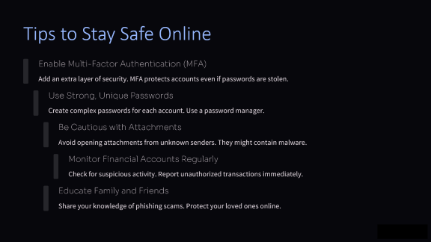
Best Practices: How to Avoid Phishing
Verify
1
Always double-check the sender's identity. Use official contact channels.
2
Hover
Preview destination URLs before clicking. A quick hover reveals the true link.
Think
3
Be suspicious of unsolicited requests for personal information. Exercise caution.
4
Update
Keep software and antivirus programs up to date. This ensures strong defenses.
Report
5
Report any suspected phishing attempts. Notify your IT department or relevant authorities.

Slide 8
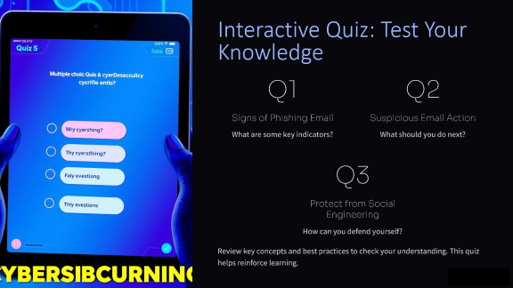
Tips to Stay Safe Online
Enable Multi-Factor Authentication (MFA)
Add an extra layer of security. MFA protects accounts even if passwords are stolen.
Use Strong, Unique Passwords
Create complex passwords for each account. Use a password manager.
Be Cautious with Attachments
Avoid opening attachments from unknown senders. They might contain malware.
Monitor Financial Accounts Regularly
Check for suspicious activity. Report unauthorized transactions immediately.
Educate Family and Friends
Share your knowledge of phishing scams. Protect your loved ones online.

Slide 9
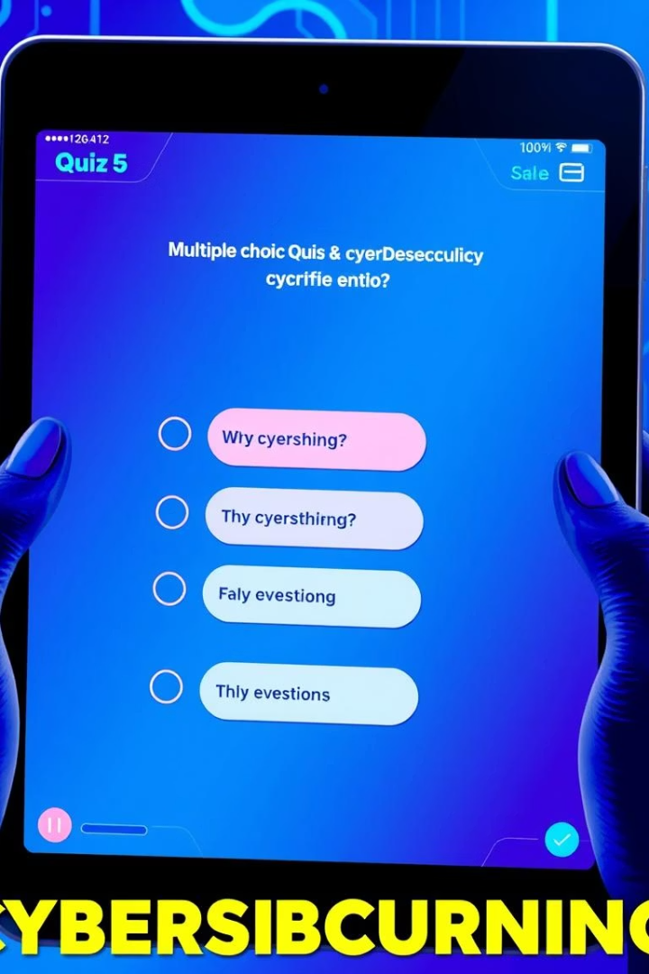
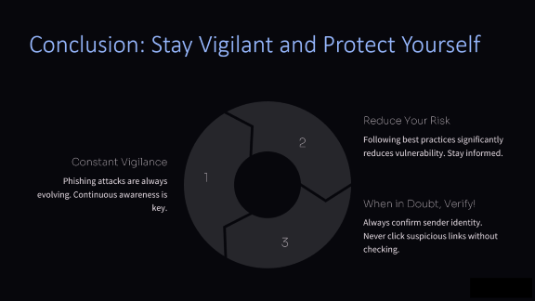
Interactive Quiz: Test Your Knowledge
Q1
Q2
Signs of Phishing Email
Suspicious Email Action
What are some key indicators?
What should you do next?
Q3
Protect from Social Engineering
How can you defend yourself?
Review key concepts and best practices to check your understanding. This quiz helps reinforce learning.

Slide 10



Conclusion: Stay Vigilant and Protect Yourself
Reduce Your Risk
2
Following best practices significantly reduces vulnerability. Stay informed.
Constant Vigilance
1
Phishing attacks are always evolving. Continuous awareness is key.
When in Doubt, Verify!
Always confirm sender identity. Never click suspicious links without checking.
3

